Slide 1

COVID-19 in NYC

Slide 2
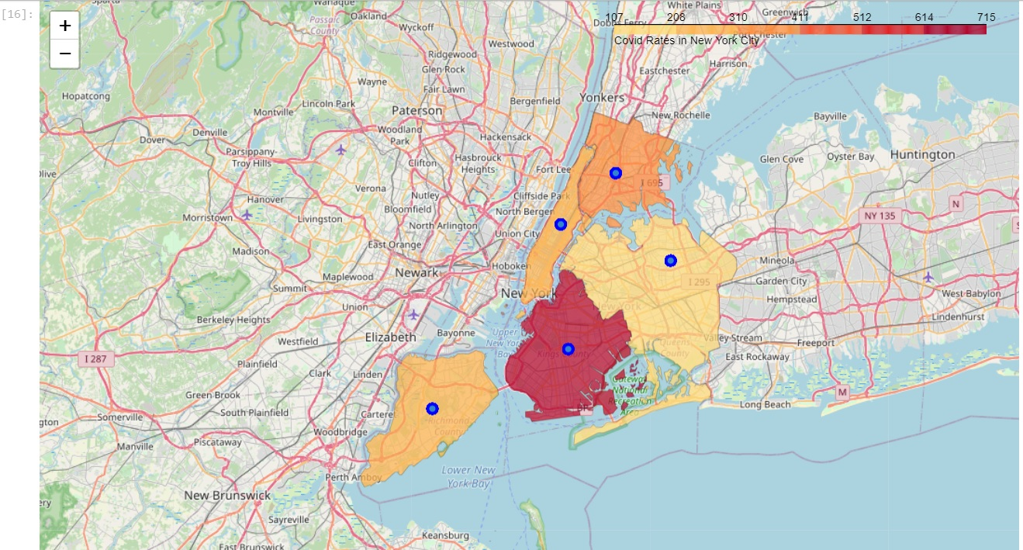
5 Major Boroughs
Bronx
Manhattan
Queens
Brooklyn
Staten Island
Here we see that Brooklyn has the highest death rate amongst the boroughs. If we narrow down to individual neighborhoods we may able to see why.

Slide 3

Sorting by Neighborhood
NYC Covid Data Sorted by ZCTA
Neighborhood Names with Cooridinates
Choropleth Map Sorted by ZCTA
NYC ZCTA Geojson File
Zip Code Tabulation Areas(ZCTA) allows us to define regions geographic areas by zip code
The COVID-19 data comes from NYC health and contains data on testing, death rates, case rates, and total cases/deaths

Slide 4
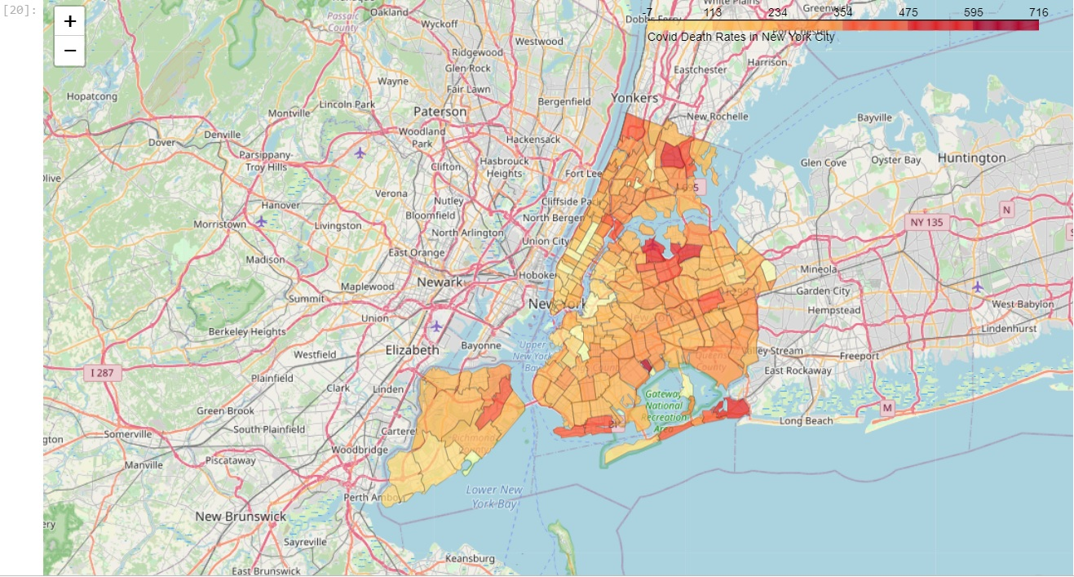
Neighborhood Choropleth Map

Slide 5
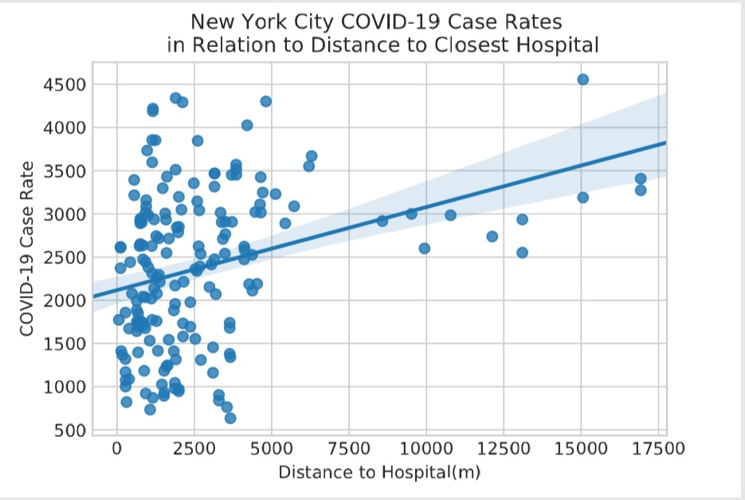
Case Rate with Distance to Hospital
Seeing a strong relationship here but many of the results are clustered in the 0-5000m range. It is possible that case rates are higher further from hospitals because they aren’t receiving the care needed to recover from the virus faster

Slide 6
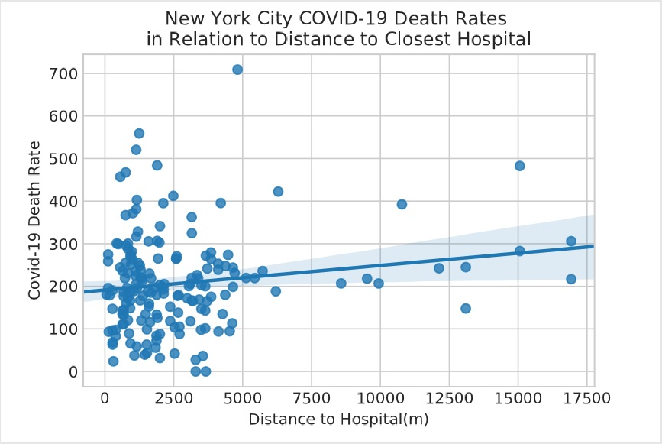
Death Rate with Distance to Hospital
Surprisingly, we did not see a strong relationship here as the graph shows. This is a positive indicator in regards to availability of care currently in New York City

Slide 7
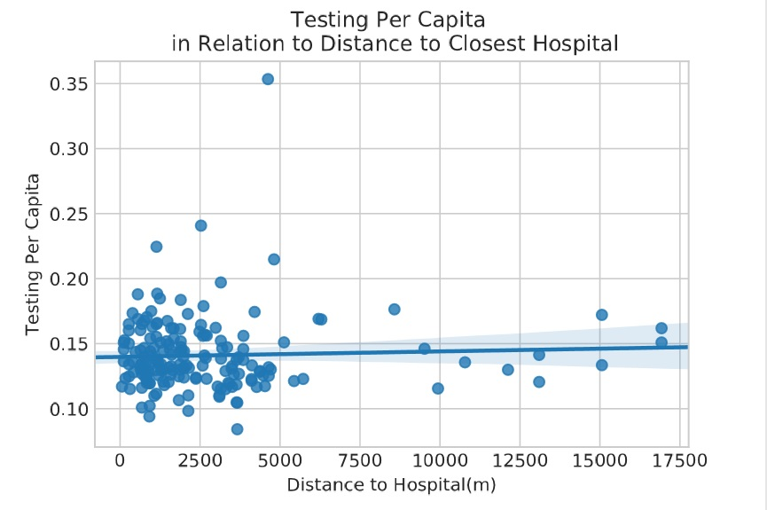
Testing per Capita
Perhaps the most positive outcome of the data is that testing per capita is consistent regardless of neighborhood which is a key factor in controlling the spread and having effective contact tracing.

Slide 8
Conclusions
Hospitals in NYC
The concentration of hospitals in some areas of Brooklyn could explain the higher death rates
Testing in NYC
Based on the testing per capita in neighborhoods it does seem that testing is available equally in all neighborhoods
Continuing to set up testing centers and critical care centers outside of hospitals is critical in providing equal care
Future
The studies do now show a need for building more hospitals in the city currently despite the threat of the hospitals being overcrowded
In order for contact tracing to be effective the city needs to continue to test heavily and equally across regions

